Slide 1
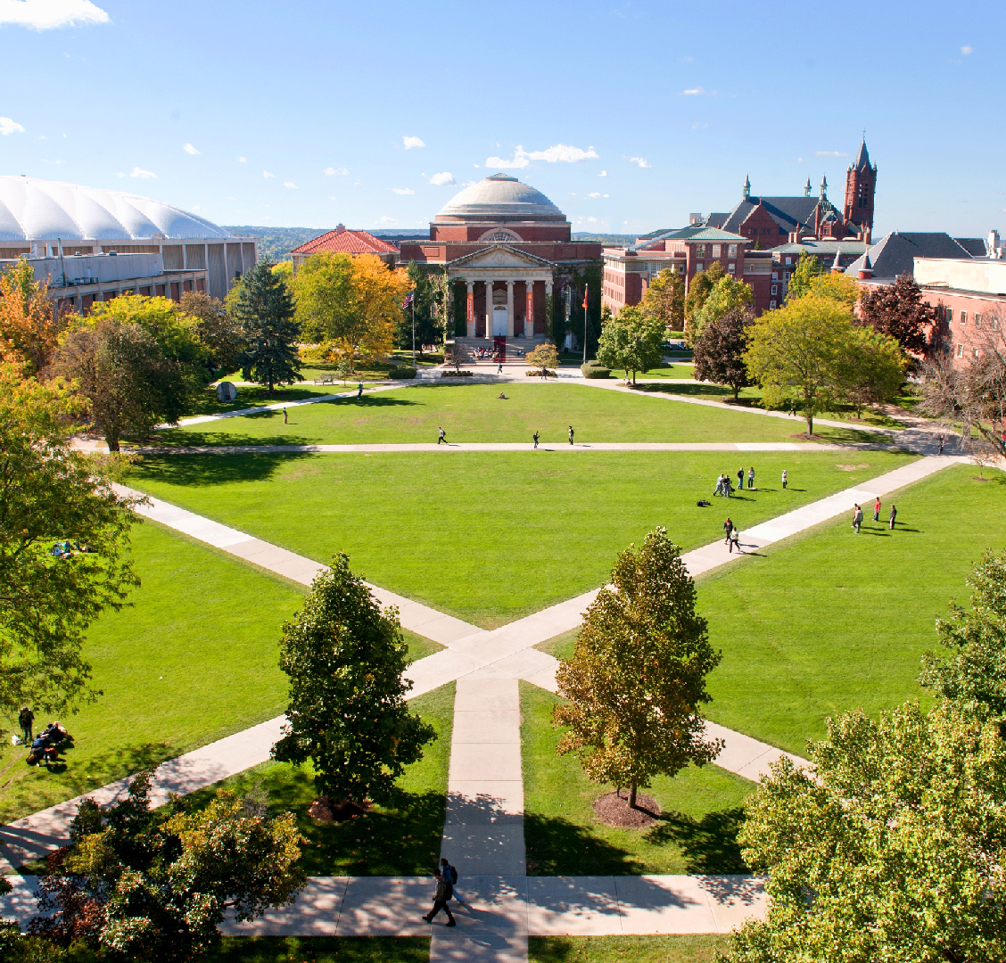


Masters of Science
Applied Data Science
Portfolio Milestone
Peter Mathews
SUID: 455606416
March 19th, 2021
https://github.com/pete_math/portfolio_milestone

Slide 2
Outline of Presentation
About Me
Introduction
Learning Objectives and Example Projects
Describe a broad overview of the major practice areas of data science.
Collect and organize data.
Identify patterns in data via visualization, statistical analysis, and data mining.
Develop alternative strategies based on the data.
Develop a plan of action to implement the business decisions derived from the analyses.
Demonstrate communication skills regarding data and its analysis for managers, IT professionals, programmers,
statisticians, and other relevant professionals in their organization.
7. Synthesize the ethical dimensions of data science practice (e.g., privacy).
Conclusion & Thank You!
Syracuse University
2

Slide 3
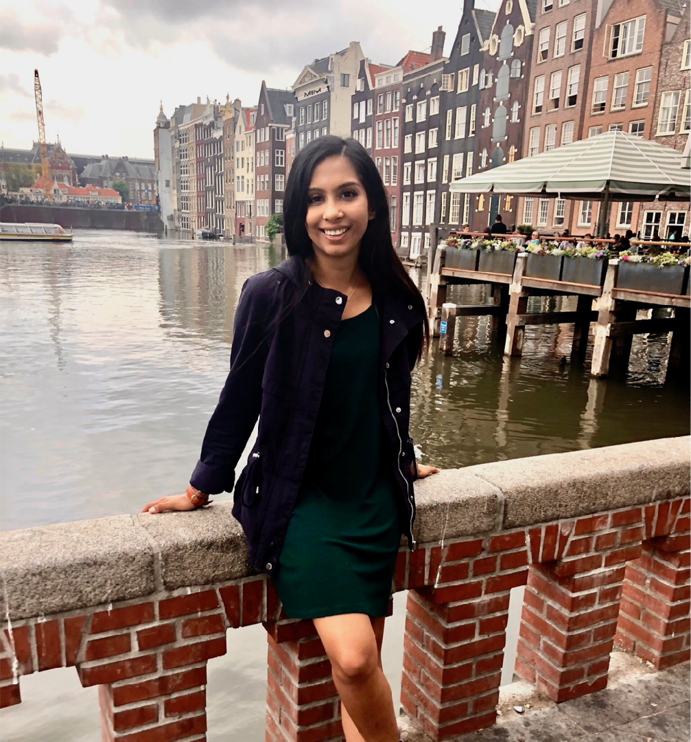
About Me
Born and Raised in Buffalo, NY. Currently reside in NYC.
Live amateur show junkie: Plays, comedy and jazz are my top 3.
Enjoy spending time with my wife and daughter.
Why did I decided to pursue my masters in data science?
Syracuse University
3

Slide 4
Introduction
The Applied Data Science curriculum at Syracuse University’s School of
Information Studies provides students the opportunity to collect, manage,
analyze, develop, and implement insights using data from a multitude of
disciplines using various tools and techniques.
In general, the curriculum, has provided the relevant and applicable knowledge,
training, resources, and academic environment for its students to progress and
impart skills that exceed the basic roles of a data scientist
Using project based learning, students of the School of Information
Studies are able to acquire crucial experience in detecting patterns in data,
developing and implementing alternative data approaches, demonstrating
communication skills that focus on explaining technical outcomes to non-
technical recipients, and discussing the ethical scope of data science through
courses related to data privacy and policy.
Syracuse University
4

Slide 5
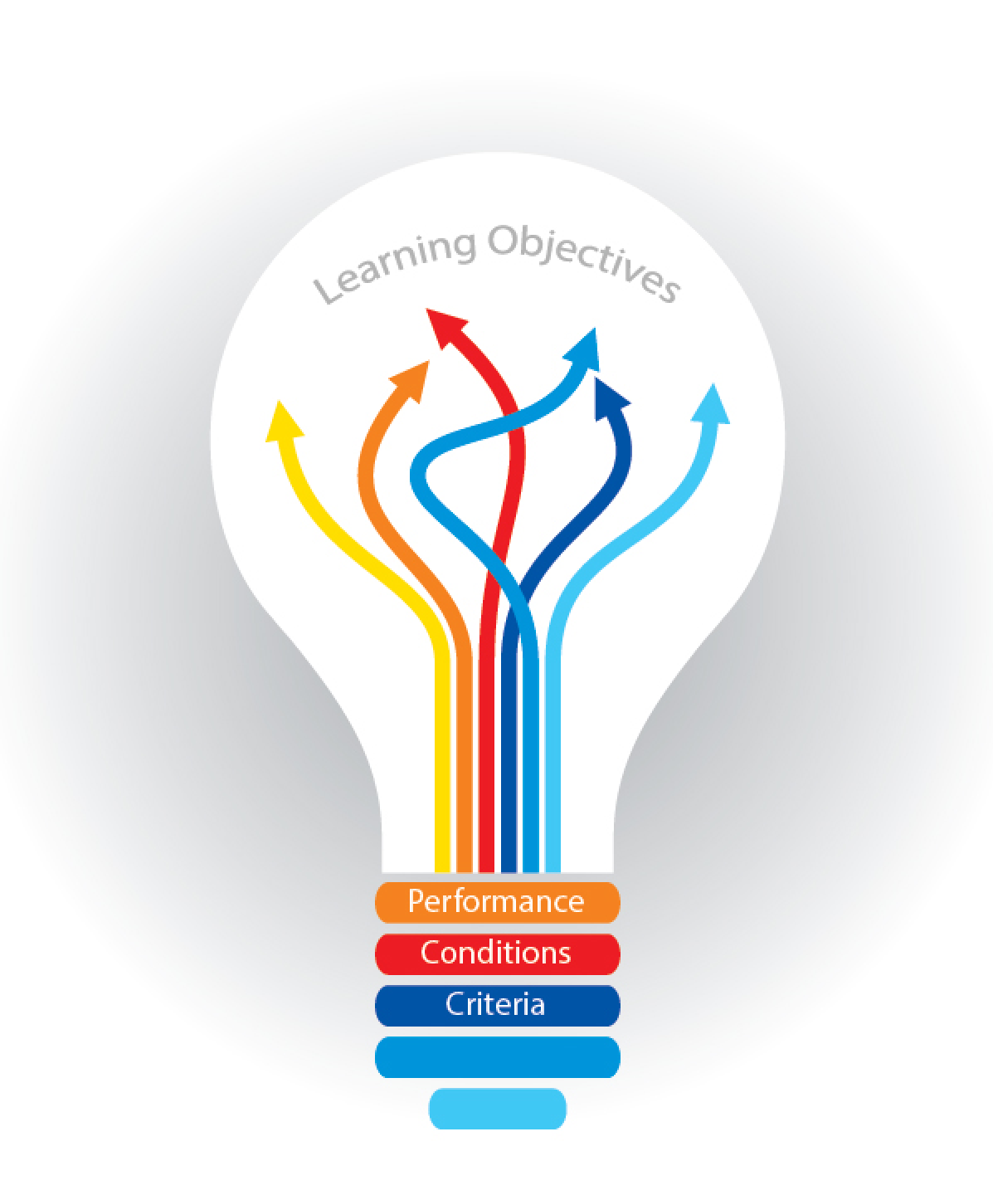
Learning Objectives
And
Example
Projects
The following slides will go through all 7 learning objectives and provide detailed examples of how these objectives were met through a brief synopsis work and projects.

Slide 6
Seven Learning Objectives of the Applied Data Science Program:
Describe a broad overview of the major practice areas of data science.
Collect and organize data.
Identify patterns in data via visualization, statistical analysis, and data mining.
Develop alternative strategies based on the data.
Develop a plan of action to implement the business decisions derived from
Demonstrate communication skills regarding data and its analysis for
the analyses.
managers, IT professionals, programmers, statisticians, and other relevant
professionals in their organization.
7. Synthesize the ethical dimensions of data science practice (e.g., privacy).
Syracuse University
6

Slide 7
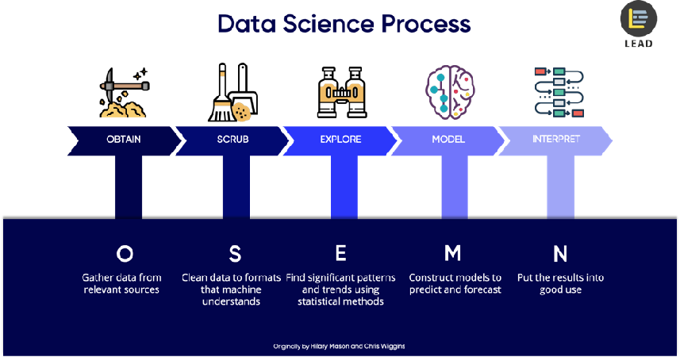
Objective 1:
Describe a broad overview of the major practice areas of data science.

Slide 8
Objective 1: Describe a broad overview of the major practice areas of data science.
In simple terms, a data scientist’s job is to analyze data for actionable insights.
Data science is the field of study that combines domain expertise, programming skills, and knowledge of mathematics and statistics to extract meaningful insights from data.
Data science practitioners apply machine learning algorithms to text, images, video, audio, and more to build data related products and services.
In turn, these systems generate actionable insights which ideally will translate business value
Syracuse University
Syracuse University
3
9

Slide 9
Objective 1: Describe a broad overview of the major practice areas of data science.
What does the work really entail?
1. Ask the right questions to begin the discovery process
2. Acquire data
3. Process and clean the data
4. Integrate and store data
5. Initial data investigation and exploratory data analysis
6. Choose one or more potential models and algorithms
7. Apply data science techniques, such as machine learning, statistical modeling, and artificial intelligence
8. Measure and improve results
9. Present final result to stakeholders
10. Make adjustments based on feedback
11. Repeat the process to solve a new problem
Syracuse University
Syracuse University
3
9

Slide 10

Objective 2:
Collect and Organize Data

Slide 11
Objective 2: Collect and Organize Data
Structured and Unstructured data
Data comes in multiple formats.
Two primary ways of describing these formats are structured and unstructured data.
Structured data is highly-organized and formatted in a way so it's easily searchable
Unstructured data has no pre-defined format or organization, making it much more difficult to collect, process, and analyze.
Syracuse University
Syracuse University
3
9

Slide 12
Objective 2: Collect and Organize Data
Administration Concepts and Database Management (IST-659)
This project aimed to design a database for a web-based commercial real estate deal (sales and loans) tracking system for use by commercial real estate brokers (both sales and financing).
I successfully demonstrated skills in data management and organization by taking collected information from a web form to build a SQL database using Microsoft Sql Server.
Once collected, I was able to query the database using SQL to answer data questions and gain insight.
Syracuse University
12

Slide 13
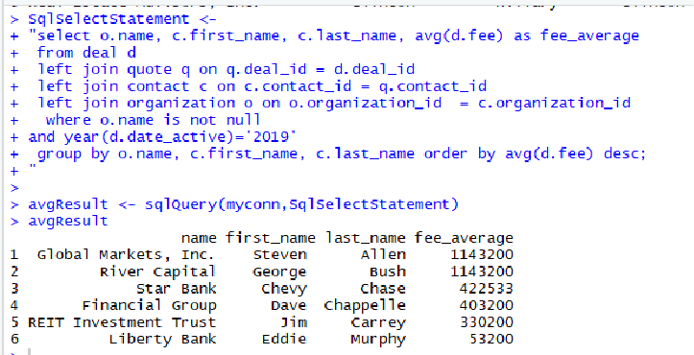
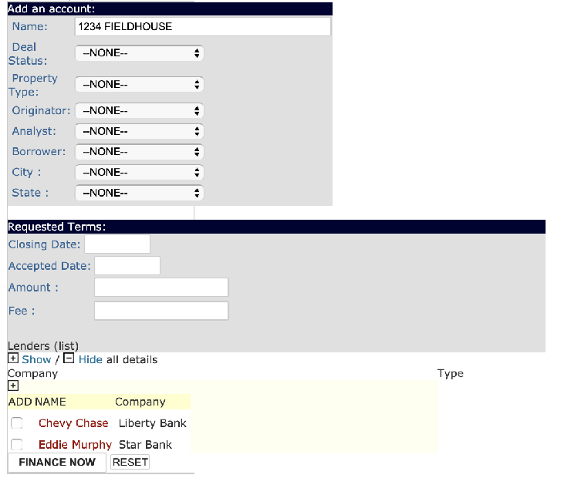
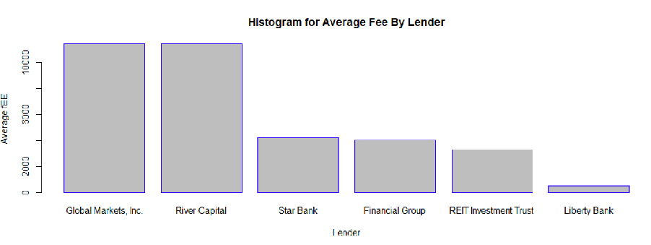
Objective 2: Collect and Organize Data
Administration Concepts and Database Management (IST-659)
Figure 1: Organization , GUI Front-End of Database
Figure 1: Data Organization
Syracuse University
13

Slide 14
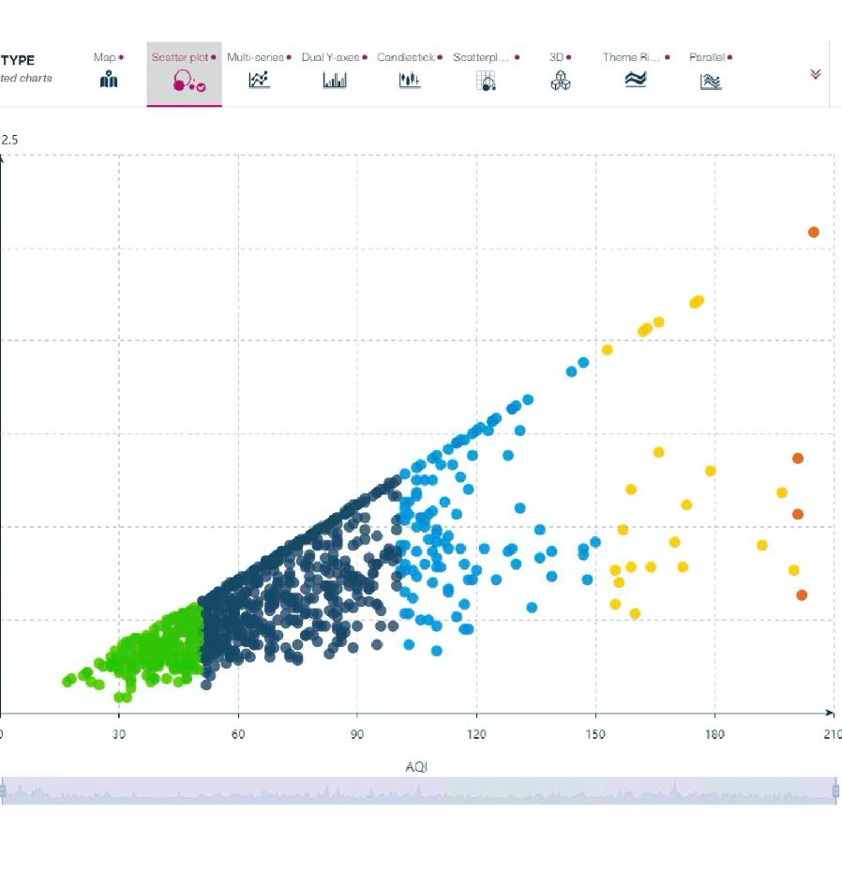
Objective 3:
Identify Patterns in Data Via: Visualization, Statistical Analysis, And Data Mining.

Slide 15
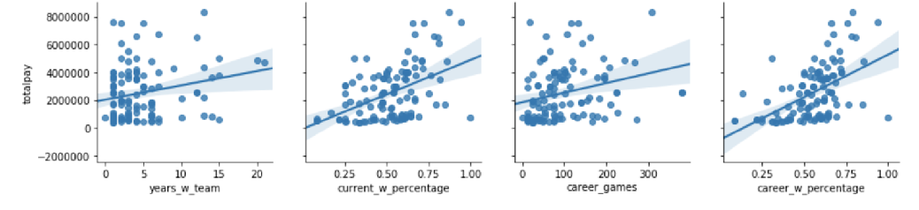
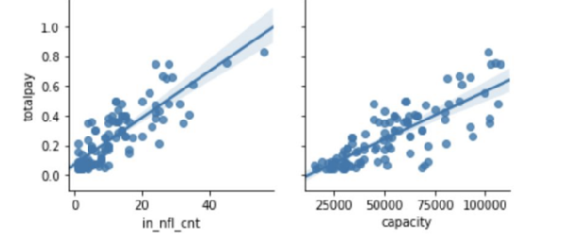
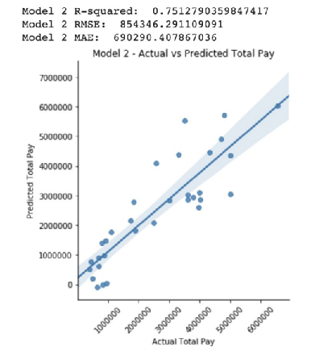
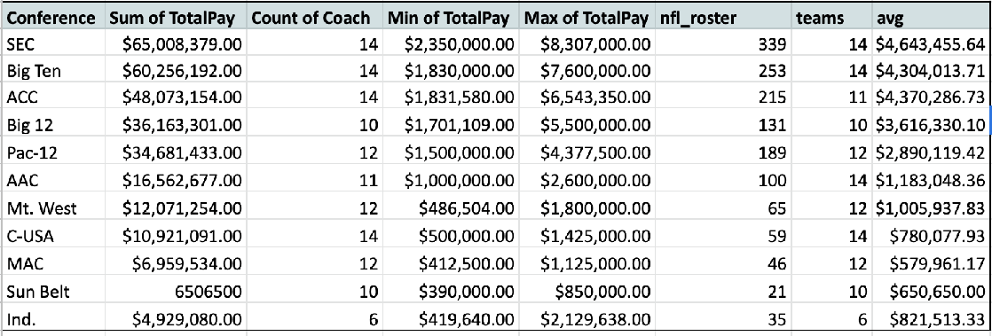
Objective 3: Identify Patterns in Data Via: Visualization, Statistical Analysis, And Data Mining.
Quantitative Analysis of a NCAA Coach’s Salary
Syracuse University

Slide 16


Objective 4:
Objective 4:
Develop Alternative Strategies Based on The Data
Develop Alternative Strategies Based on The Data

Slide 17
Objective 4: Develop Alternative Strategies Based on The Data
Big Data Analytics (IST-718)
To better understand the opioid epidemic in New York and to provide a tool to assist health and law enforcement officials in managing the crisis as this is an ongoing, urgent problem throughout our society
At close to 25 gigabytes, this was a very large dataset. In order to fit the dataset in Google Colab, the original dataset from the DEA ARCOS database was narrowed down to 8.88 million observations by filtering the data to focus only on Hydrocodone and Oxycodone’s drugs.
The results were both accurate and actionable. However, training and testing the model took significant time. If we wanted to provide a real-world tool to law enforcement, we’d need to find a way to decrease training.
Using Rapids.ai, I was able to retain the same level of accuracy from the model, however, cut the training time down from 4 mins to 3 secs.
Syracuse University
20

Slide 18
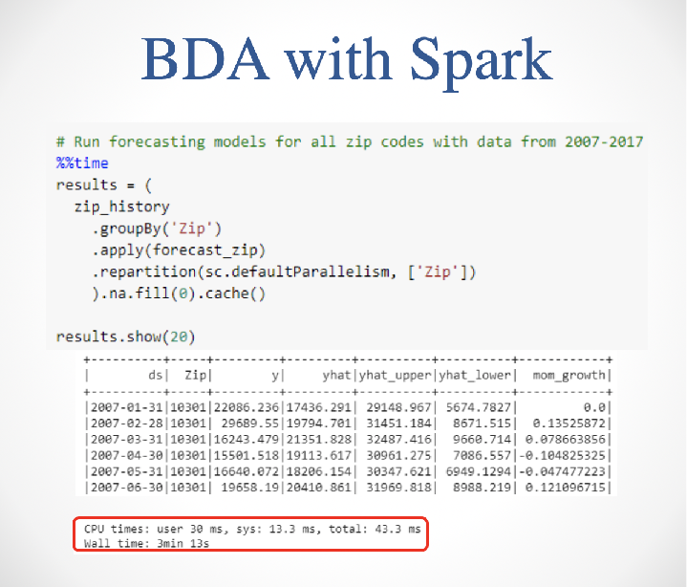
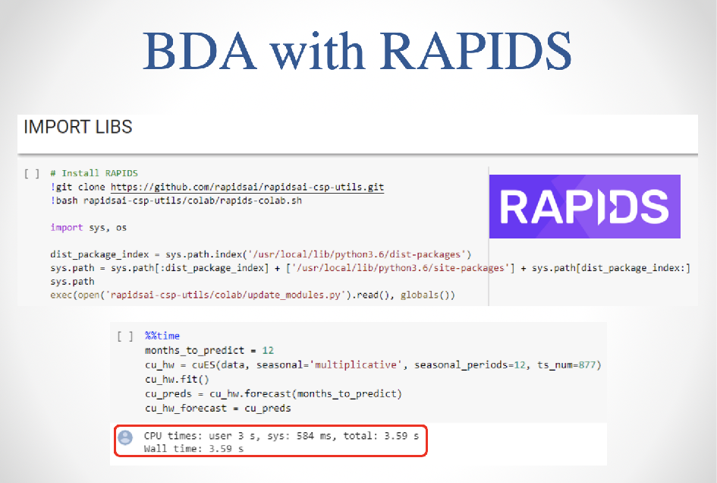
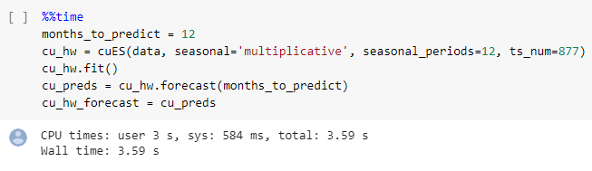
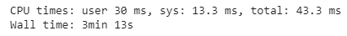
Objective 4: Develop Alternative Strategies Based on The Data
Big Data Analytics (IST-718)
Figure 1: Organization , GUI Front-End of Database
Figure 1: Data Organization
Syracuse University
13

Slide 19

Objective 5:
Develop A Plan of Action to Implement the Business
Decisions Derived from The
Analyses

Slide 20

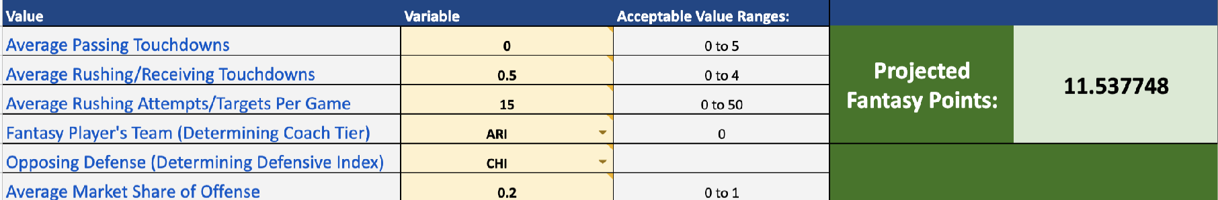
Objective 5: Develop A Plan of Action to Implement the Business Decisions Derived from The Analyses.
Big Data Analytics (IST- 718)
The goal of this analysis is to identify the 3 top zip codes for Syracuse REIT (SREIT) to evaluate for investment. Given the specific function of SREIT as a builder and seller of single-family homes, this analysis will serve as a potential roadmap for future investments.
Using FaceBook’s Prophet time-series library in conjunction with Apache Spark, I was able to identify the 3 top zip codes for investments and present my findings in a clear manner
Syracuse University
23

Slide 21

Objective 6:
Demonstrate Communication
Skills Regarding Data and Its Analysis for
Managers, IT Professionals, Programmers, Statisticians, And Other Relevant
Professionals in Their Organization.

Slide 22
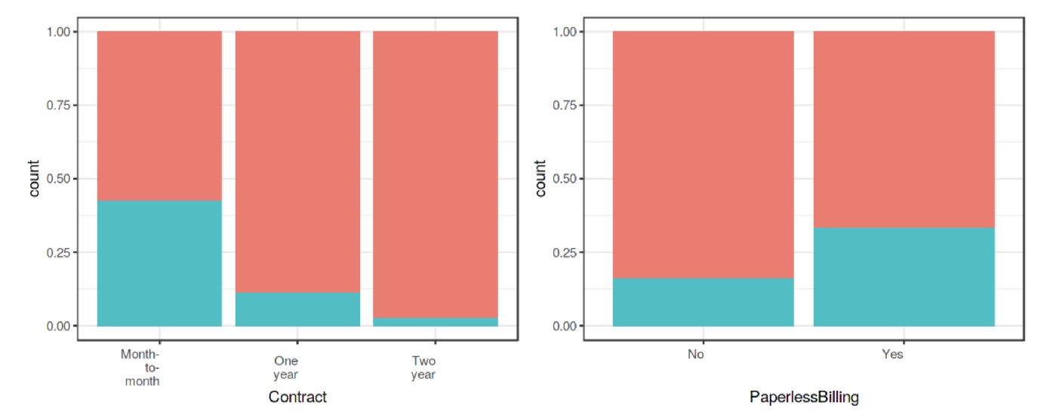
Objective 5: Develop A Plan of Action to Implement the Business Decisions Derived from The Analyses.
Marketing Analytics (MAR-653)
If a customer has a one-year contract and not using paperless billing, they are unlikely to churn​​
If a customer has a month-to-month contract, and is in the tenure group of 0-12 months, and uses paperless billing, they are more likely to churn (78% chance of churn)
To remain competitive, we recommend locking customers into a contract of at least one year, ensuring terms are agreeable and attractive to customers, to reduce the likelihood of churn.
We recommend focusing on demographic changes in needs of telecommunications companies, as older generations may be reliable customers for the short terms, while younger generations may churn more quickly in favor of other methods of communication.
As contract length increases, likelihood of churn decreases
Syracuse University
24

Slide 23
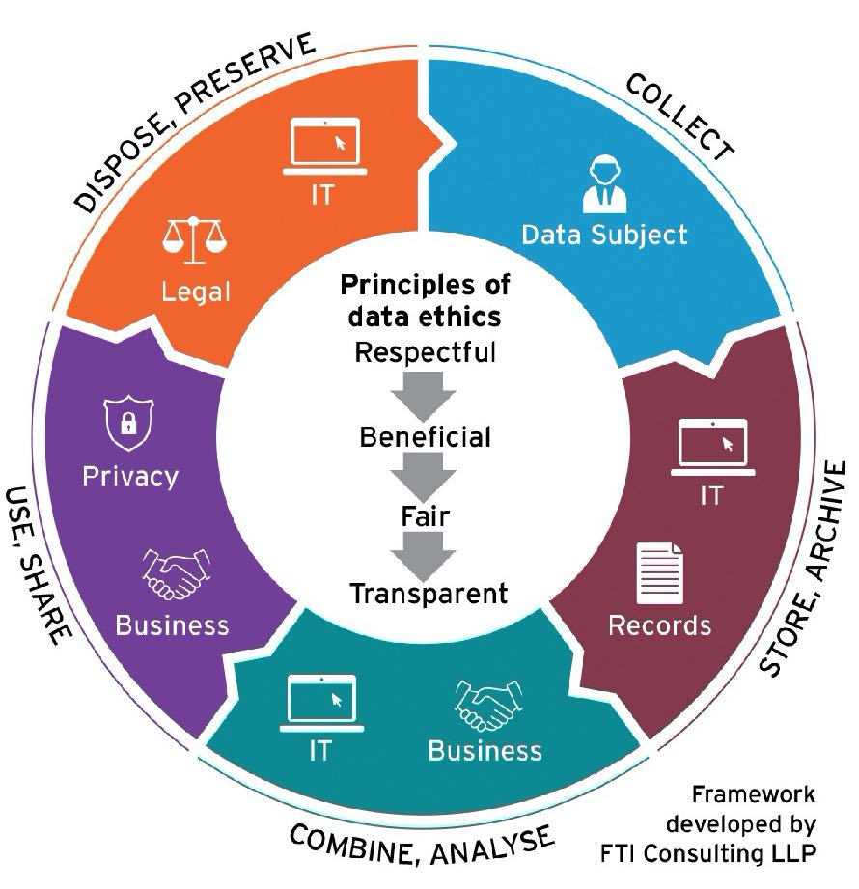
Objective 7:
Synthesize the Ethical
Dimensions of Data Science Practice

Slide 24
Objective 7: Synthesize the Ethical Dimensions of Data Science Practice.
How can we address privacy, transparency and fairness in our process?
Have we studied and understood possible sources of bias in our data? Is our training data fair and representative?
Data Scientist need to conscientiously prepare to address the ethical problems that appear during the use of data
Have we received user consent? Is our process transparent when users initially provide data to us?
Is our data secure? Have we insured privacy to the best of our ability?
Syracuse University
30

Slide 25


Thank You!
Overall, the M.S. in Applied Data Science has been a challenging but rewarding experience. Not only did it provide the necessary steps for my future, it allowed me to make lasting friends and connections with fellow students.
This program really represents the springboard to my next stage in my career!

